Slide 1
Constant Modulus Algorithm
U. B. Desai
SPANN Lab.
EE Dept
ubdesai@ee.iitb.ac.in
http://www.ee.iitb.ac.in/student/~ee608/
http://www.ee.iitb.ac.in/~ubdesai/EE608%202008/

Slide 2
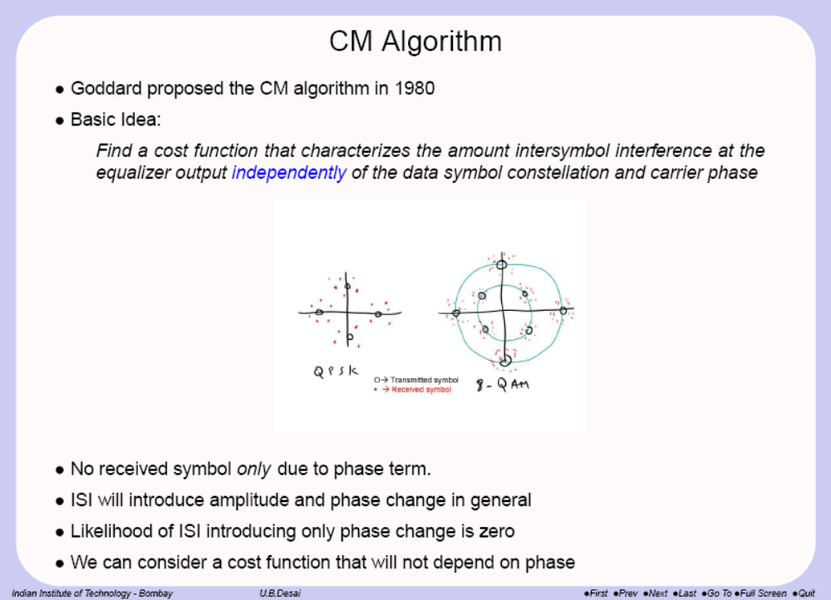

Slide 3
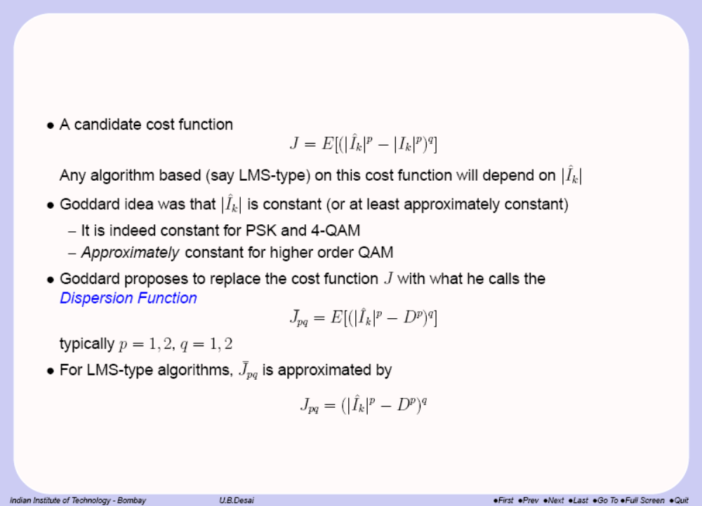

Slide 4
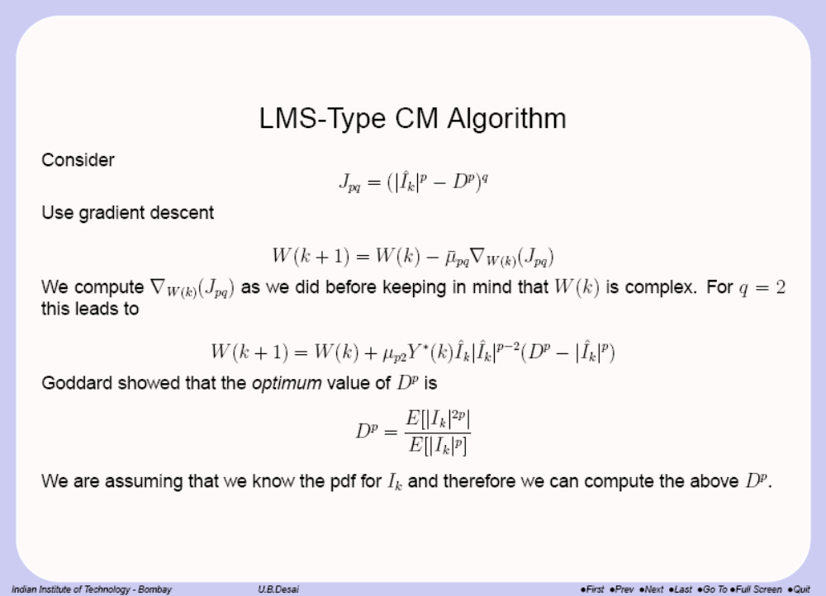

Slide 5
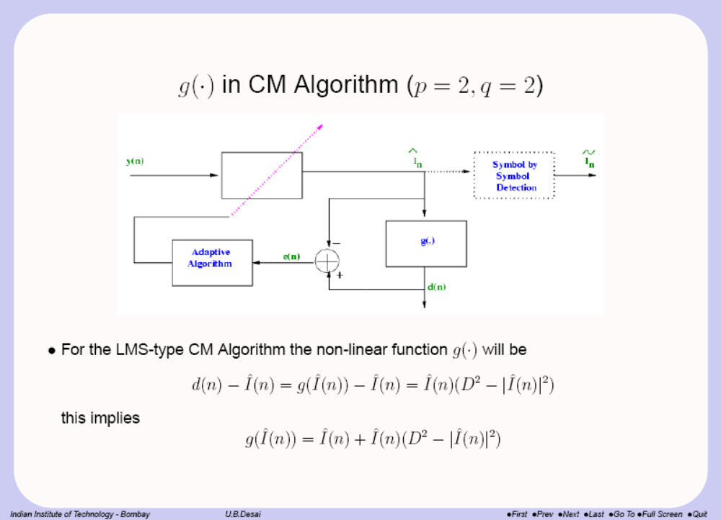

Slide 6
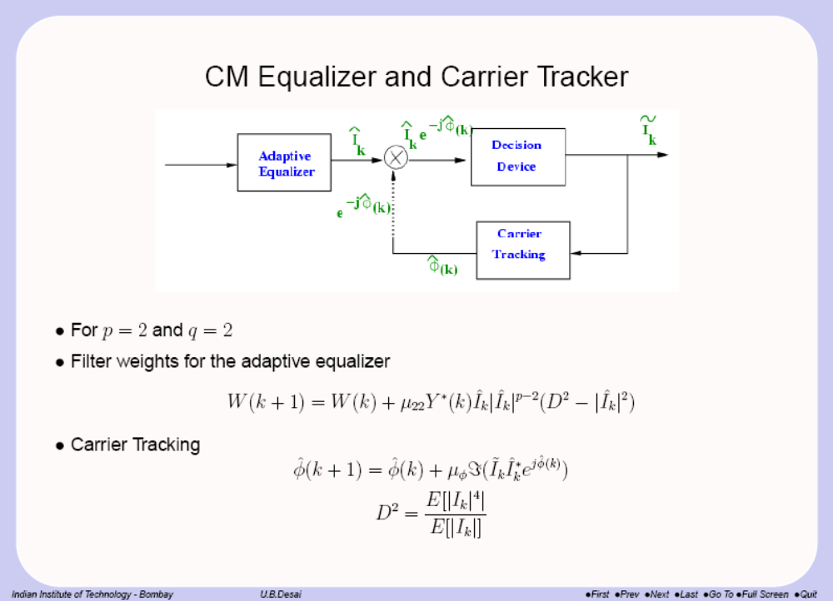

Slide 7
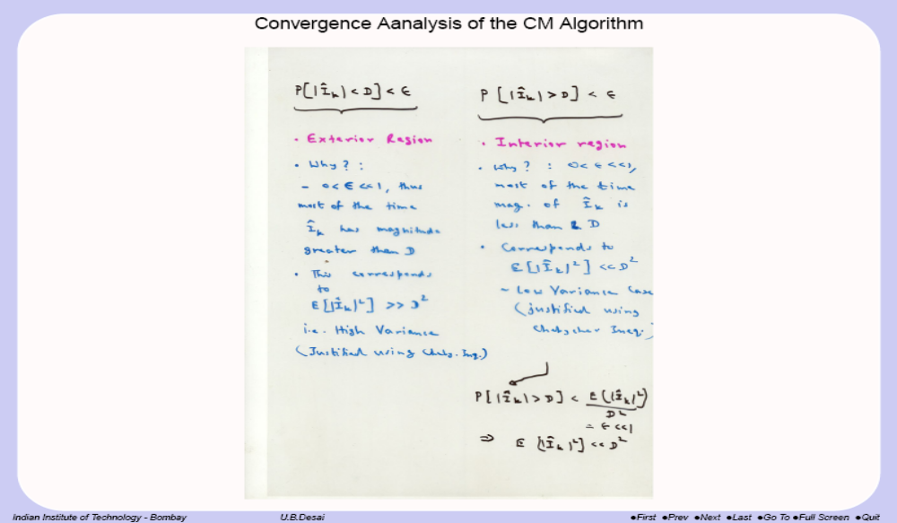

Slide 8
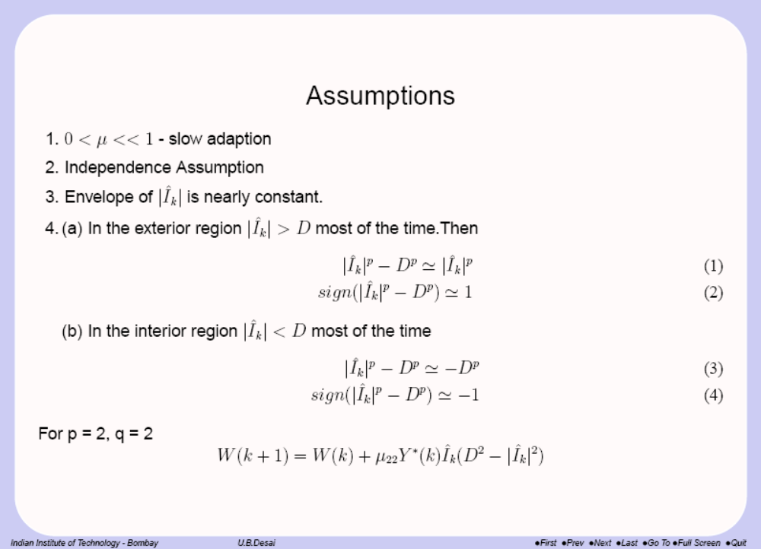

Slide 9
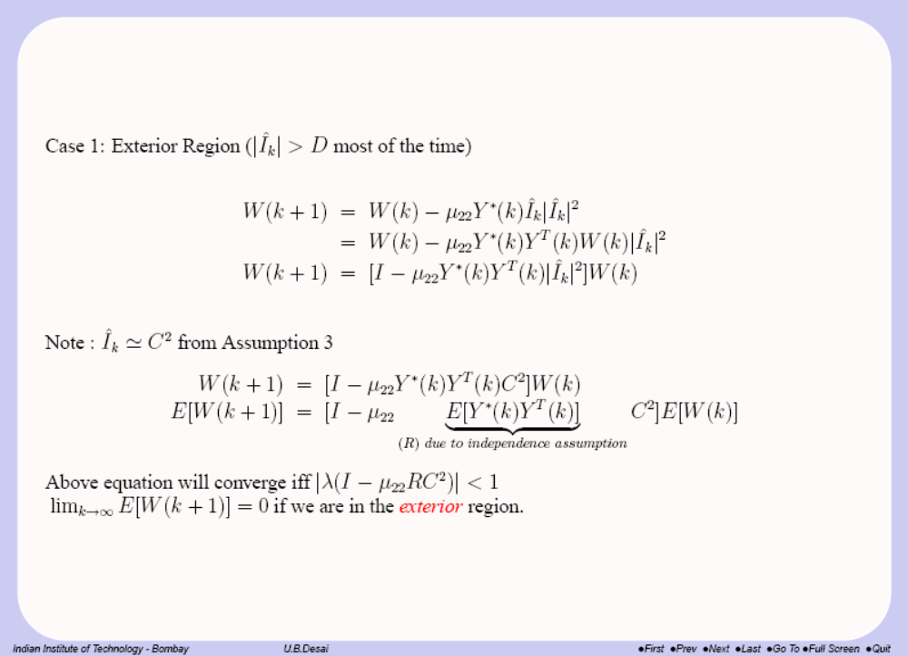

Slide 10
